Slide 1
NCMS CONNECT · COMPLIANCE PACKAGE BUILDER
UI States Review Deck — Part 2
Re-shot against the confirmed deactivation-only lifecycle. Publish date and effective date are now separate, events and modules cannot be deactivated while an active package still uses them, and grace periods sit at the package level. Twenty-four states across four flows.
Source: ncms-package-lifecycle-stories.html · Prepared by Swovo Design
Click through live: ncms-package-lifecycle-stories.html — every slide below has a matching card in the Story Hub.

Slide 2
REVIEW NOTES
What changed since the last review
CONFIRMED IN THIS PASS
OPEN — NEEDS NCMS CONFIRMATION
Deactivation only. “Deprecated” and “archived” are gone. A package is Draft, Published, Inactive (superseded by a later version) or Deactivated (retired by an admin). Packages have no reactivate.
Events and modules cannot be deactivated while in use. A pre-check names the active packages holding the item and the action stays unavailable until it is removed from all of them. The message is inline, not a modal.
Events and modules are not versioned. Changing a configuration means creating a new one and deactivating the original. The Version History row action is gone from both libraries as a result.
Effective date is separate from publish date. Required on publish, defaults to today. It is when the compliance timer starts and when the previous version goes Inactive.
Grace periods are set at the package level. One grant covers an employee across every rule in the package. Confirmed in Wes's written feedback.
Can NCMS staff test a package between its publish date and its effective date? The lead time is now a real window in the flow, and nothing in the design says whether it is usable for internal verification before contractors see it.
Contractors with NCMS Connect access but no operator package. Should a general package apply to them by default? Raised by Wes; needs an answer before the edge case can be designed.
Every state in this deck is reachable in the live prototype via the Story Hub — four flows, twenty-four cards, one per slide.

Slide 3
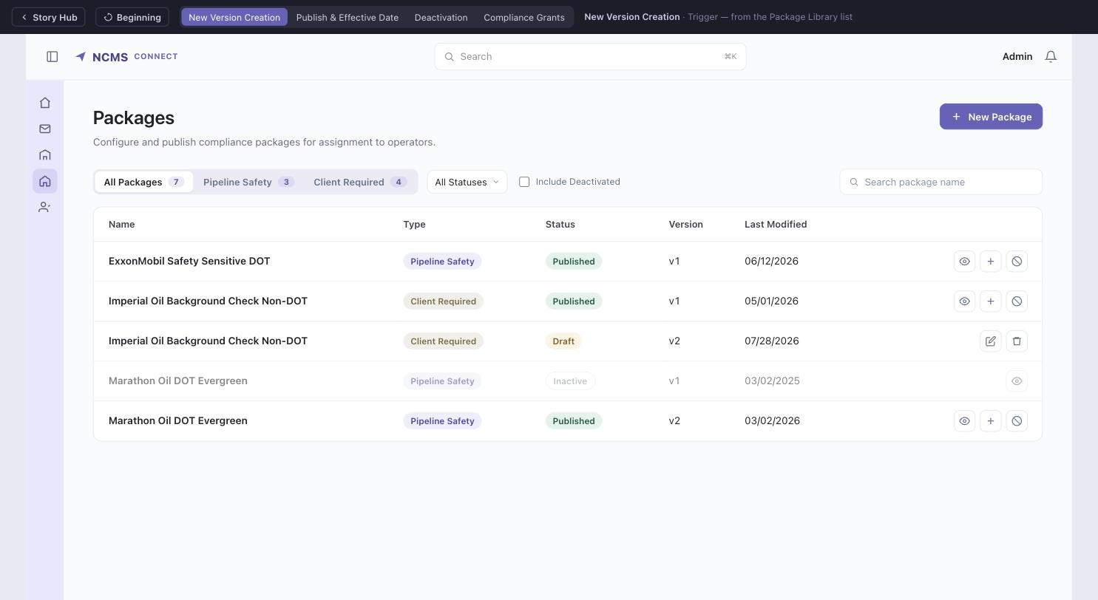
NEW VERSION CREATION FLOW
Trigger — Package Library row action
Clicking New Version on a Published package clones it into a new Draft (vN+1) and opens the builder directly. Statuses are now Draft, Published, Inactive and Deactivated — Archived is gone.

Slide 4
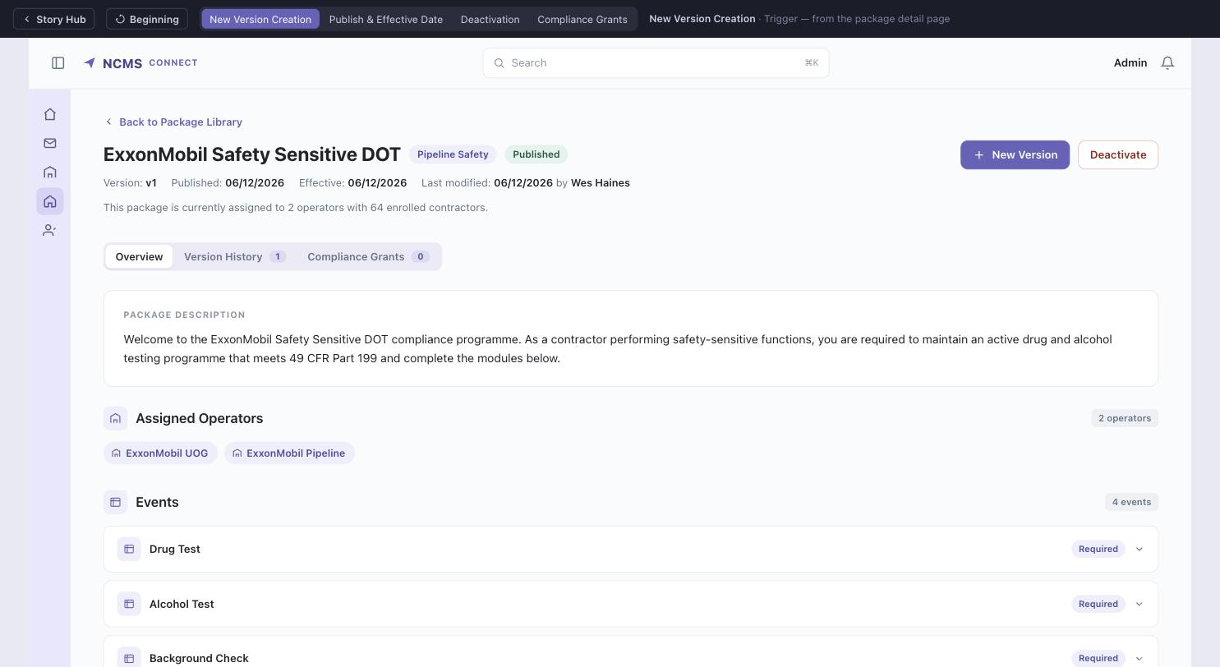
NEW VERSION CREATION FLOW
Trigger — published package detail page
The same action is available from the package's own detail header, which now carries the effective date alongside the publish date. Archive is no longer offered.

Slide 5
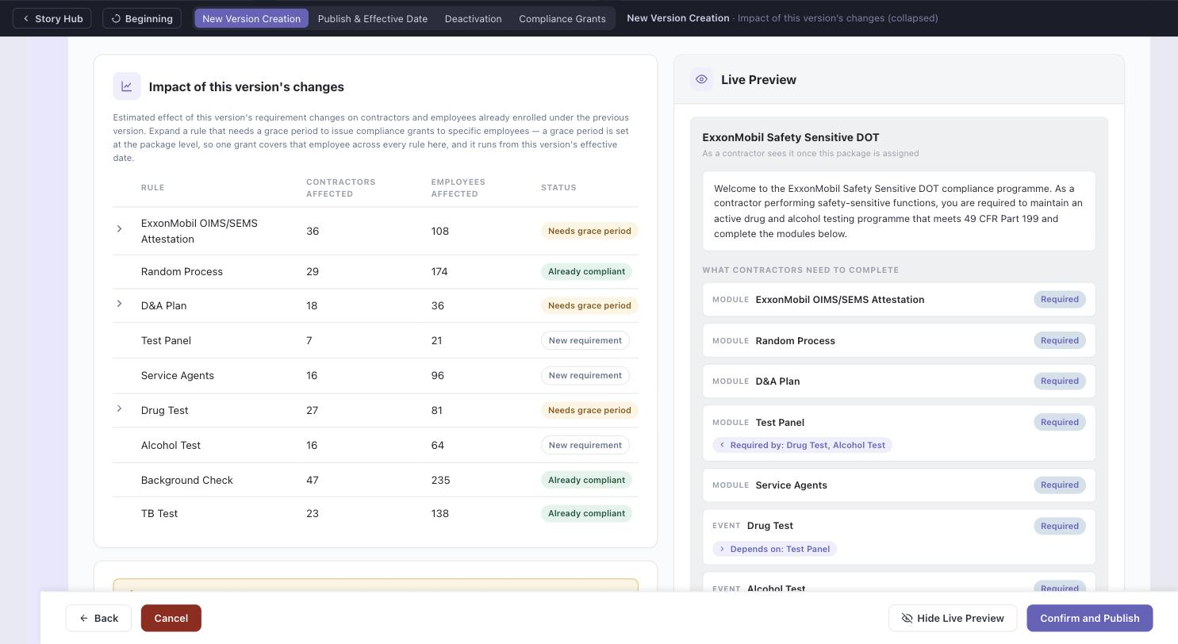
NEW VERSION CREATION FLOW
Impact of this version's changes (collapsed)
New-version-only section. Estimates the effect of this version's requirement changes on already-enrolled contractors and employees, rule by rule.

Slide 6
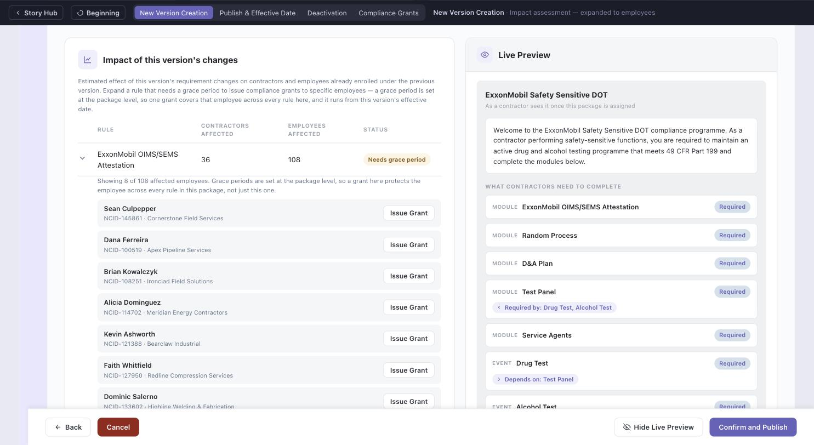
NEW VERSION CREATION FLOW
Impact assessment — expanded to employees
Rows marked Needs grace period expand into the specific affected employees, each with an Issue Grant action. One grant covers that employee across every rule in the package.

Slide 7
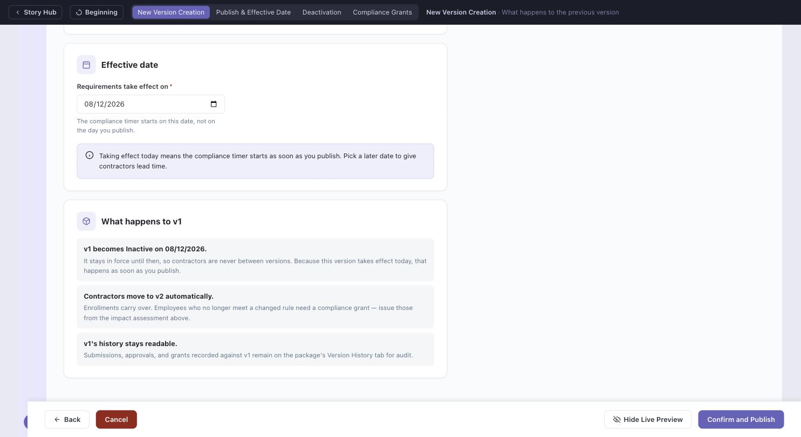
NEW VERSION CREATION FLOW
What happens to the previous version
No longer a choice. The previous version becomes Inactive on the new version's effective date — not on its publish date — so contractors are never between versions.

Slide 8
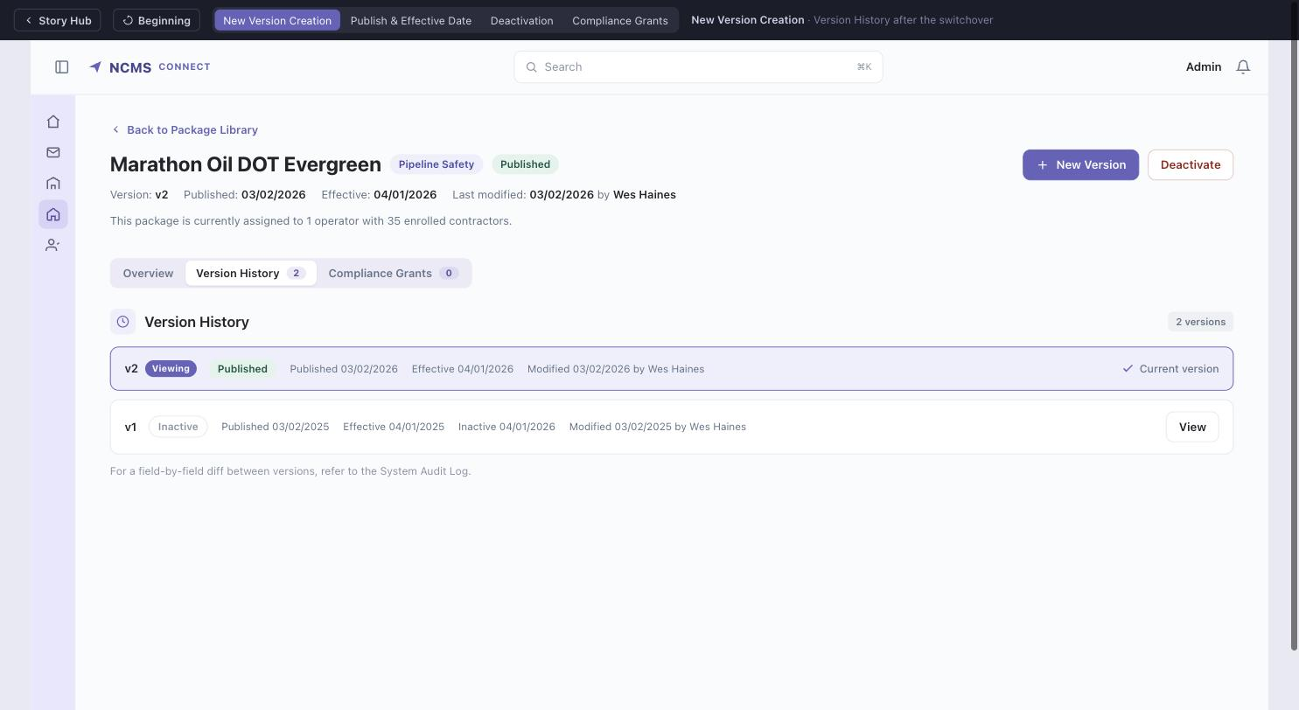
NEW VERSION CREATION FLOW
NEW STATE
Version History after the switchover
Marathon Oil: v2 was published 03/02/2026 with an 04/01/2026 effective date, and v1 went Inactive on 04/01/2026. The seeded dates show the rule holding in real data.

Slide 9
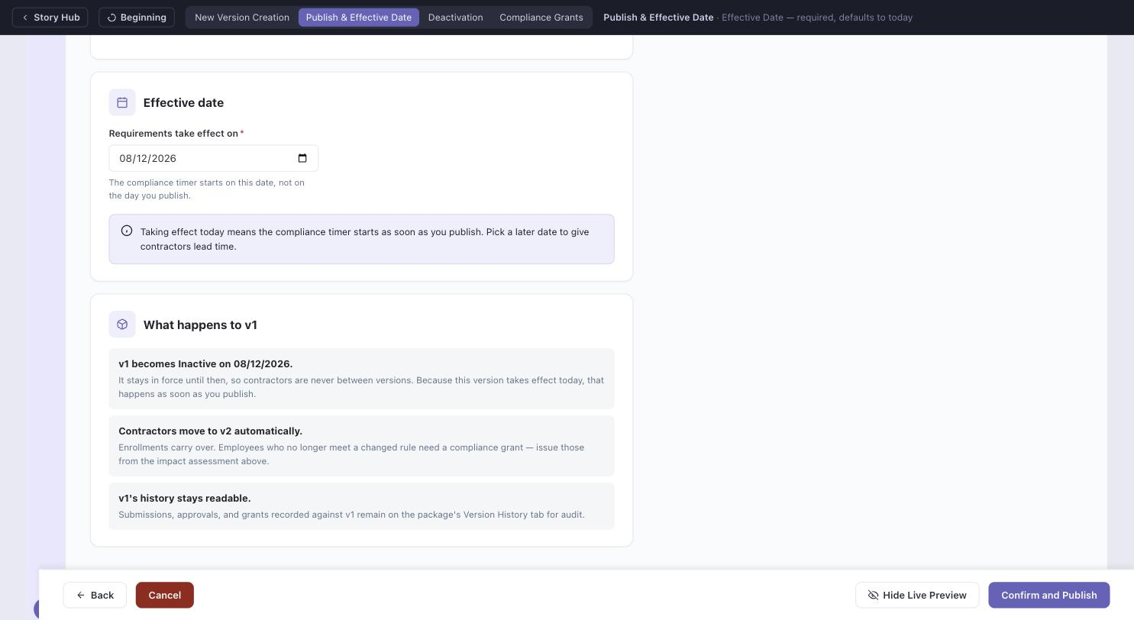
PUBLISH & EFFECTIVE DATE
NEW STATE
Effective Date — required, defaults to today
New field on Review & Publish. It is the date the compliance timer starts for enrolled contractors, not the date you publish. Clearing it disables Confirm and Publish; backdating is blocked.

Slide 10
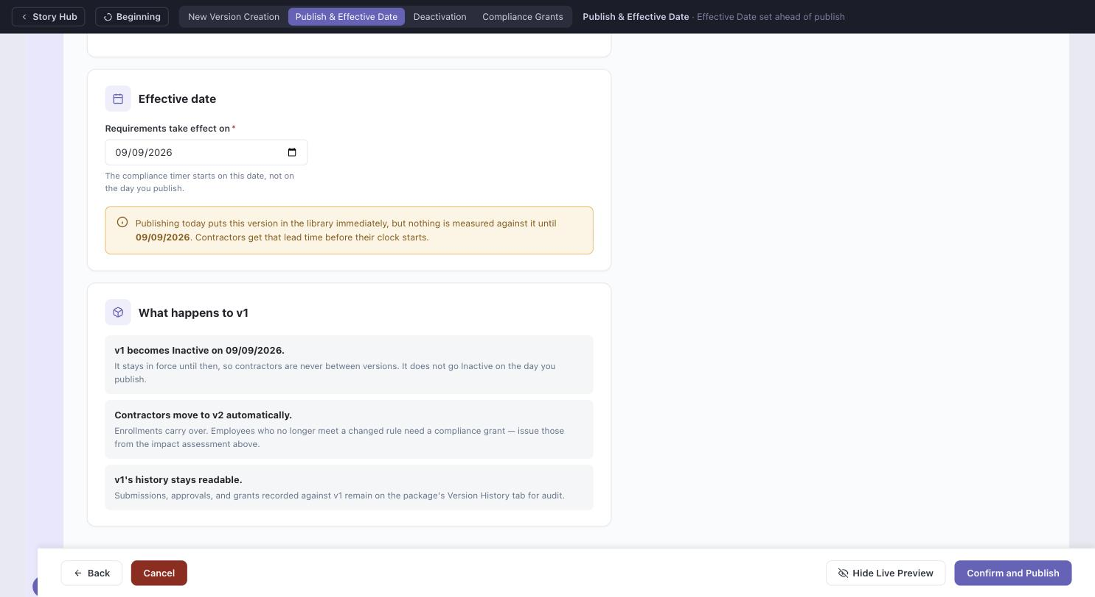
PUBLISH & EFFECTIVE DATE
NEW STATE
Effective date set ahead of publish
Publishing puts the package in the library immediately, but nothing is measured against it until the effective date. Open item: can NCMS staff test the package inside that window?

Slide 11
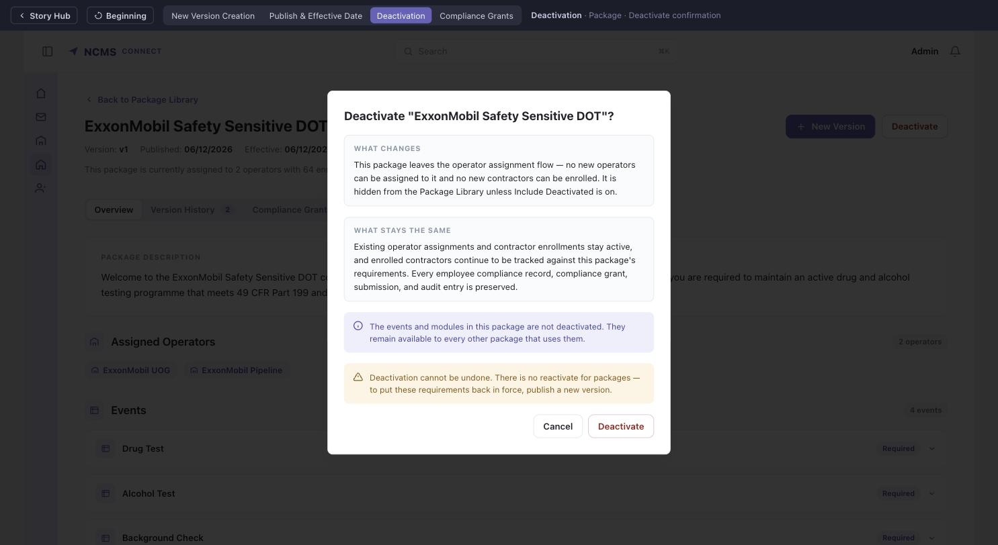
DEACTIVATION FLOWS
Package — Deactivate confirmation
Rewritten for the deactivation-only model: what changes, what stays the same, an explicit note that the package's events and modules are untouched, and no reactivate — the way back is a new version.

Slide 12
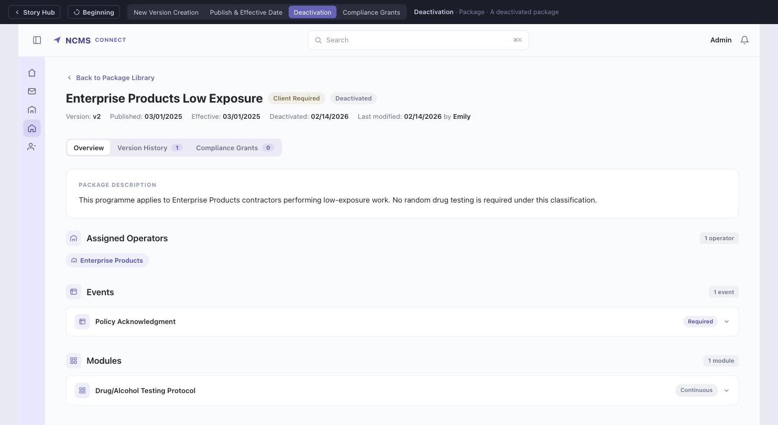
DEACTIVATION FLOWS
NEW STATE
Package — a deactivated package
Read-only. Operator assignments, contractor enrollments, compliance grants and audit history are all preserved and still visible.

Slide 13
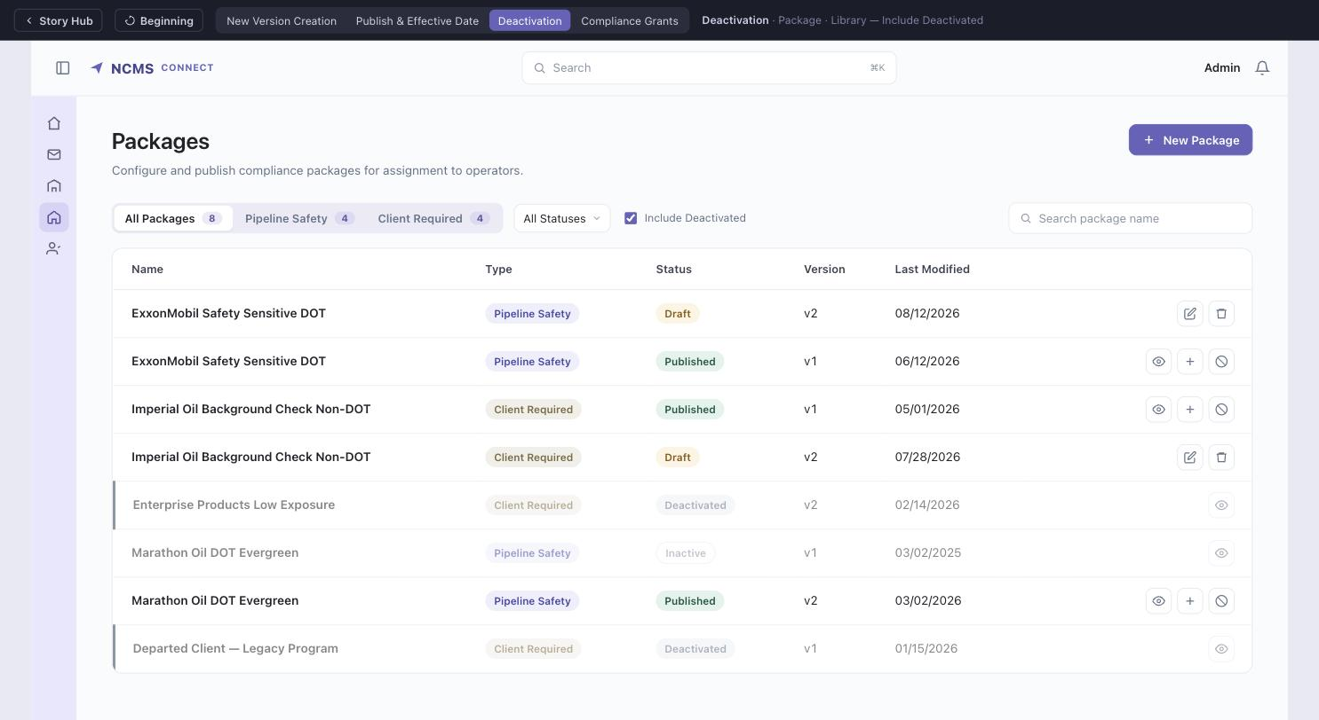
DEACTIVATION FLOWS
NEW STATE
Package Library — Include Deactivated
Deactivated packages are hidden by default and surfaced by the toggle. Inactive versions stay visible — contractors were audited against them.

Slide 14
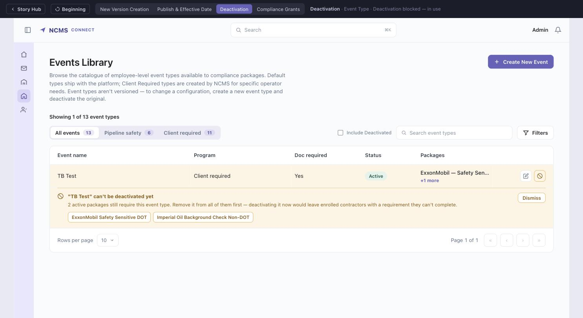
DEACTIVATION FLOWS
NEW STATE
Event Type — deactivation blocked, in use
The pre-check runs on render, so the action is already unavailable. Clicking it explains why inline — not in a modal — naming both published packages that still require TB Test.

Slide 15
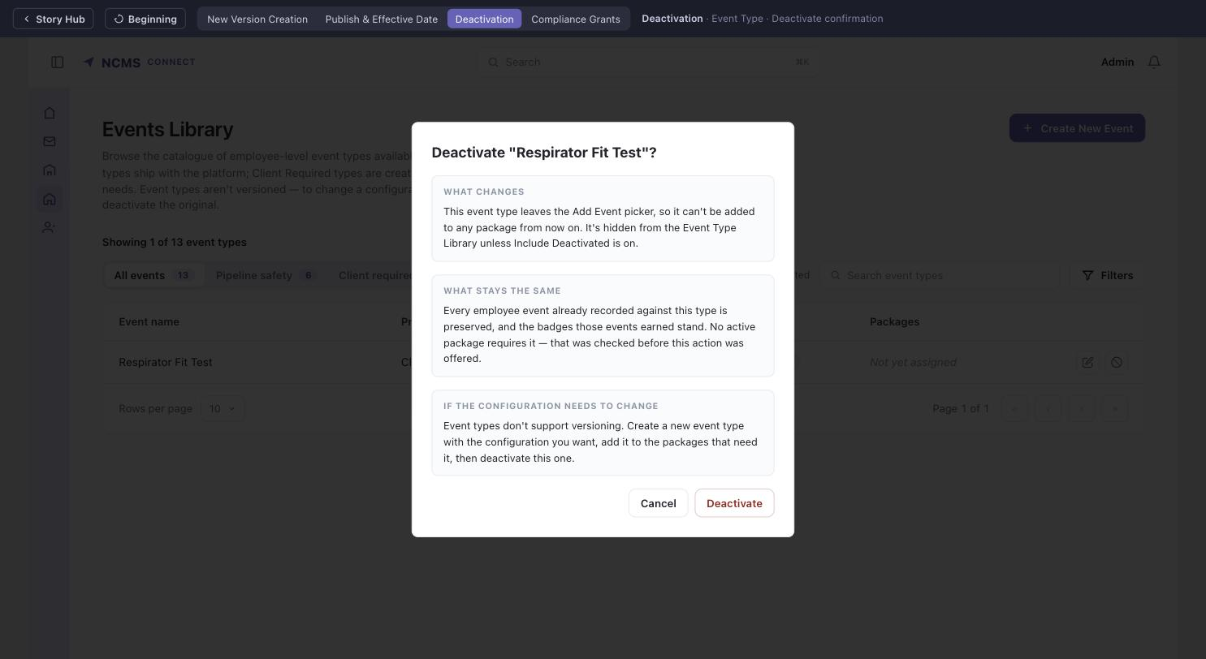
DEACTIVATION FLOWS
Event Type — Deactivate confirmation
Offered only once no active package requires the event type. Now states the confirmed no-versioning rule: create a new event type rather than changing this one in place.

Slide 16
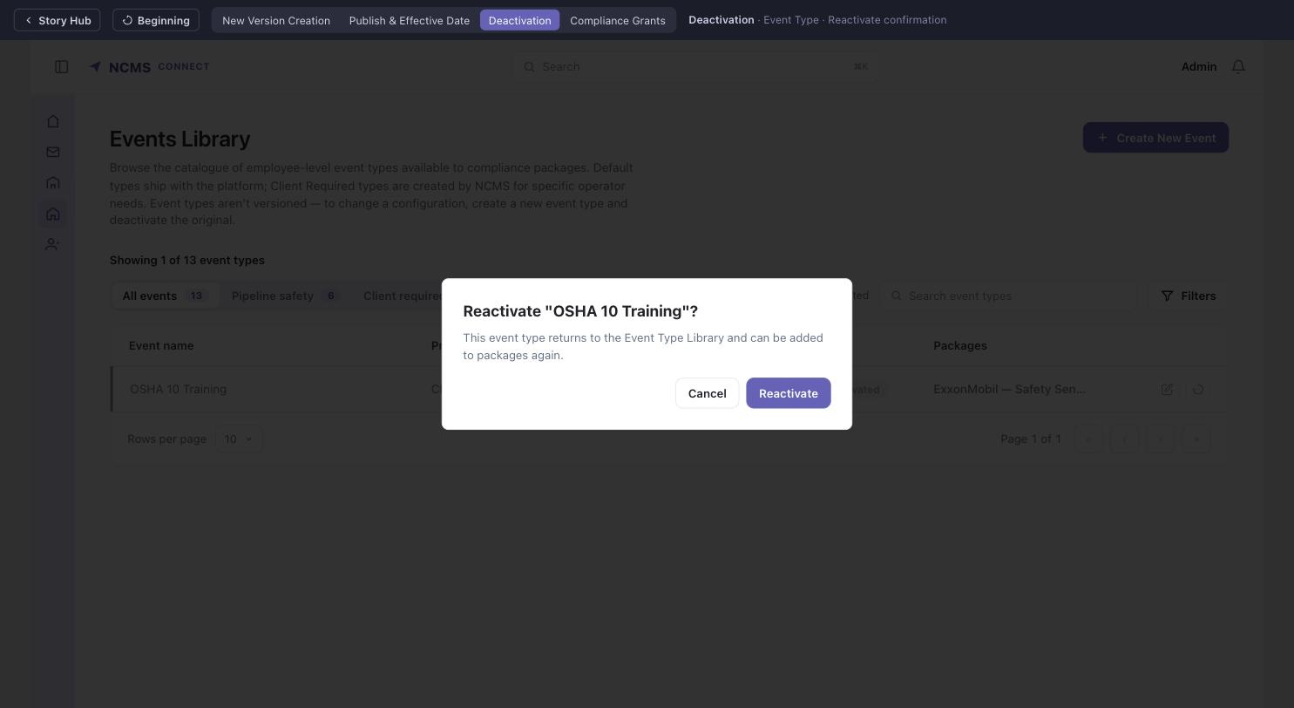
DEACTIVATION FLOWS
Event Type — Reactivate confirmation
Reverses a Deactivate; the event type becomes selectable in the Add Event picker again.

Slide 17
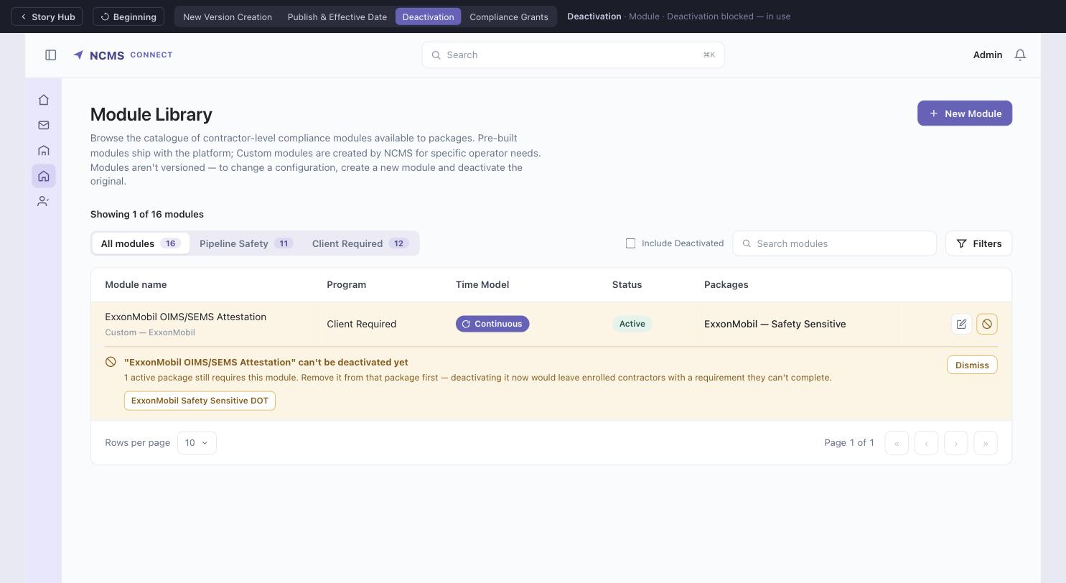
DEACTIVATION FLOWS
NEW STATE
Module — deactivation blocked, in use
The same pre-check, singular case: one published package holds the ExxonMobil OIMS/SEMS module. The Packages column and the blocking message agree.

Slide 18
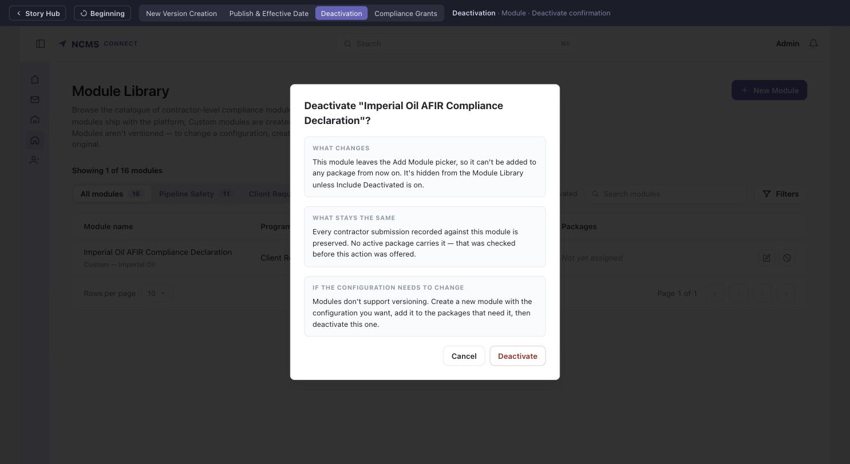
DEACTIVATION FLOWS
Module — Deactivate confirmation
Offered only for Custom-source modules, and only when no active package carries them. Carries the same no-versioning rule as event types.

Slide 19
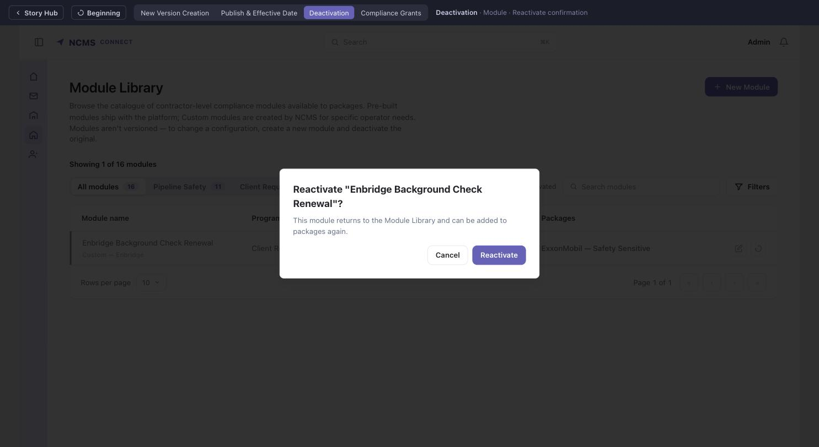
DEACTIVATION FLOWS
Module — Reactivate confirmation
Reverses a Deactivate; the module becomes selectable in the Add Module picker again.

Slide 20
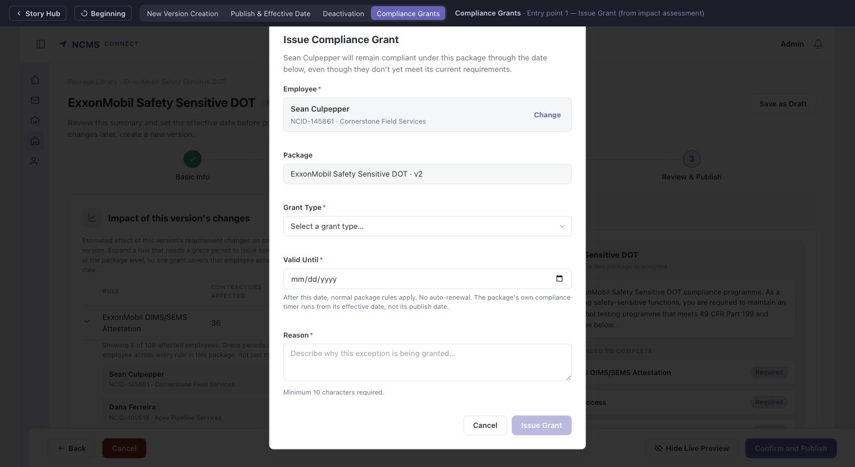
COMPLIANCE GRANT CREATION & MANAGEMENT
Entry point 1 — Issue Grant (from impact assessment)
Employee arrives pre-filled from the impact table row; the admin can still search and swap via Change.

Slide 21
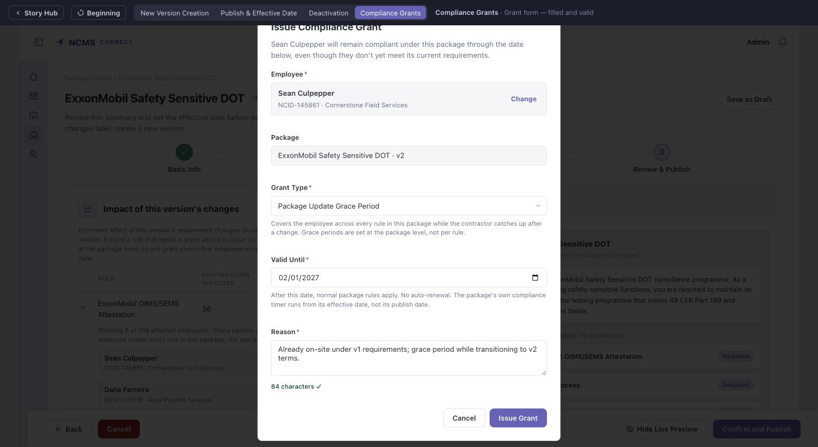
COMPLIANCE GRANT CREATION & MANAGEMENT
Grant form — filled and valid
Grant Type states that grace periods are set at the package level, not per rule. Valid Until notes that the package's compliance timer runs from its effective date. Reason enforces a live 10-character minimum.

Slide 22
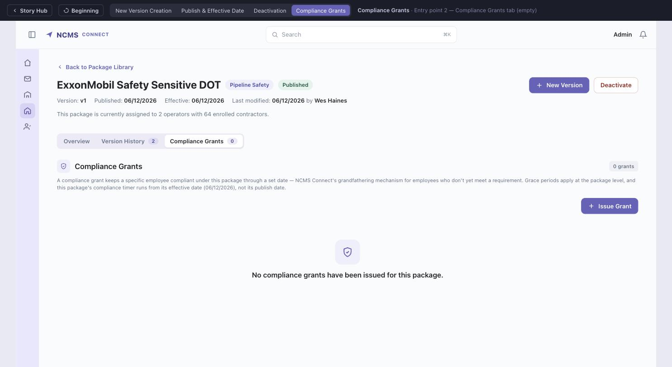
COMPLIANCE GRANT CREATION & MANAGEMENT
Entry point 2 — Compliance Grants tab (empty)
Tab on the published package detail page, alongside Overview and Version History. The intro names this package's effective date.

Slide 23
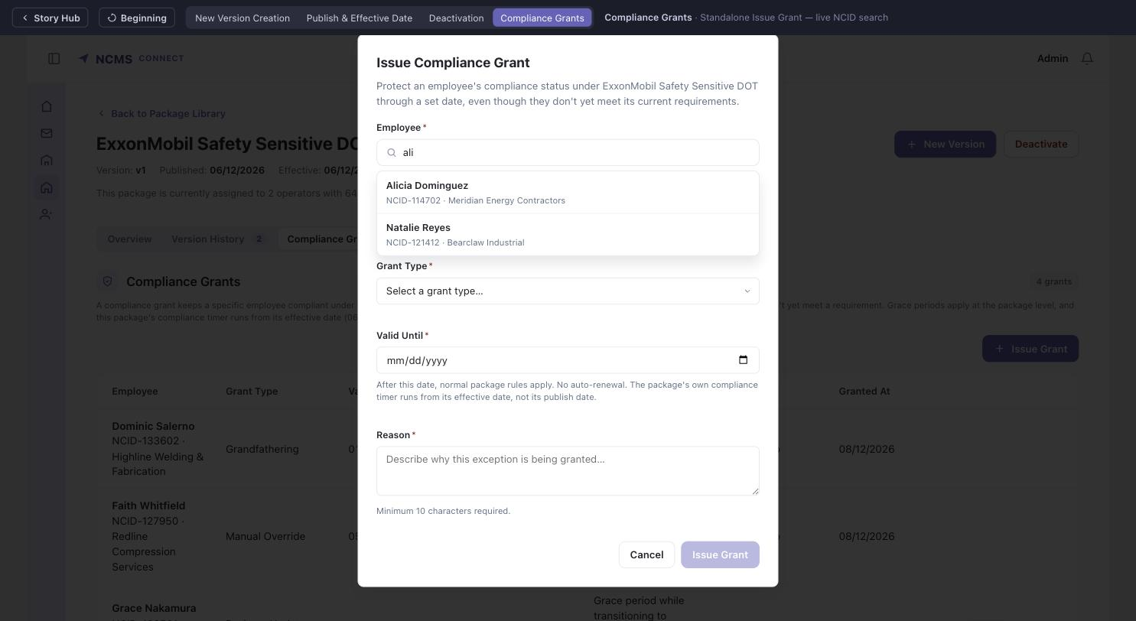
COMPLIANCE GRANT CREATION & MANAGEMENT
Standalone Issue Grant — live NCID search
Typing filters by name, NCID or contractor; results show all three for unambiguous confirmation.

Slide 24
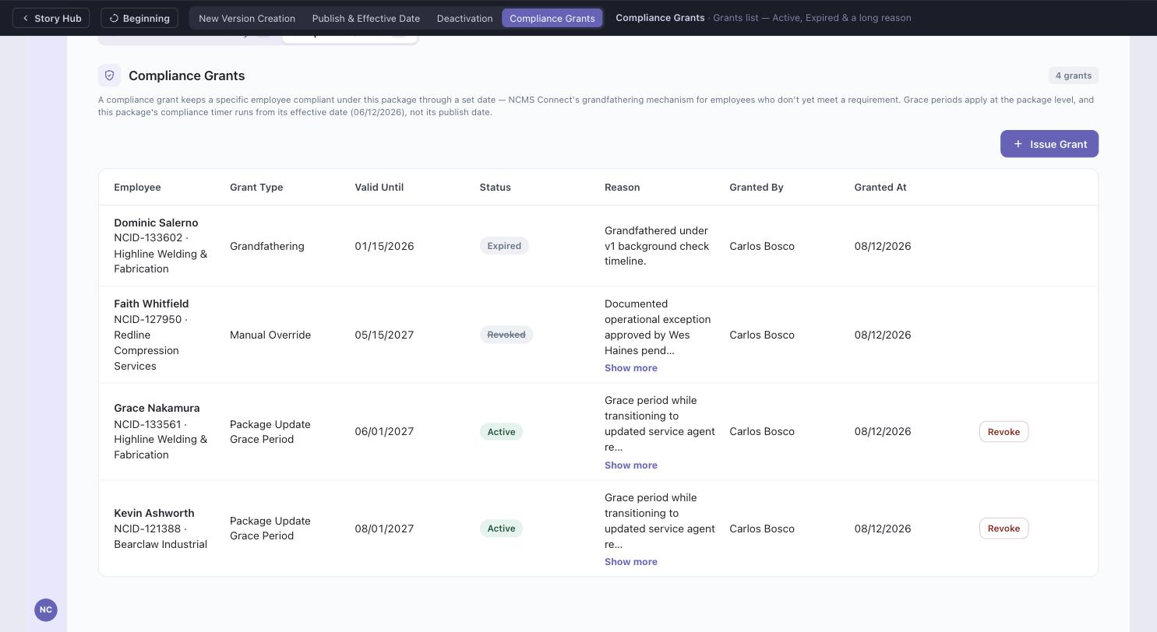
COMPLIANCE GRANT CREATION & MANAGEMENT
Grants list — Active, Expired & a long reason
Sorted by soonest-expiring first; long reasons truncate with a Show more toggle.

Slide 25
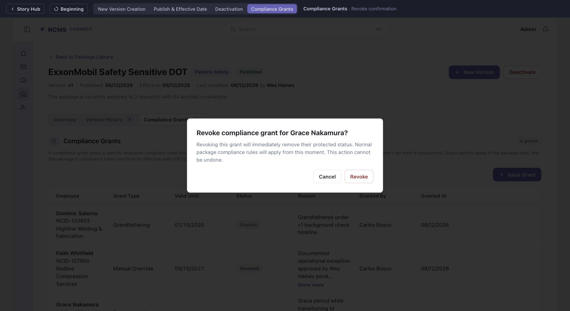
COMPLIANCE GRANT CREATION & MANAGEMENT
Revoke confirmation
Explicit destructive-consequence language; the action cannot be undone.

Slide 26

COMPLIANCE GRANT CREATION & MANAGEMENT
Post-revoke — Expired, Revoked & Active together
Revoked grants stay permanently visible with a muted, strikethrough treatment — never hidden from the list.

